Slide 1
Name :- Pralay K Kalaskar Role applied for :- Business analyst Gmail :- pkkdkalaskar71@gmail.com contact :- +91 - 7066216365
Sawara Solutions Pvt ltd (Promilo) - Student App, Colleges Search | Internships and Job Opportunities | Admission Portal

Slide 2


(EDA) exploratory data analysis to gain insights
(Identify sales trends, patterns, and outliers)
Looking for Garbage Values, NULL Values
If it is greater then 80% then drop the columns
And is it is less10% then drop the rows
To operate NULL values you can do either of these steps which is as follows :-
Null Value imputation for Categorical data : mode
Null Value imputation for Continuous data : median, mean
The next step is Outliers identification in the data
There are outliers present in the dataset. But I haven’t operated or manipulated it because it will have an adverse effect on the dataset like on the mean or total count
There are different approaches such as replacing the outlier with the mean value, or median value or in some cases dropping the observation with the suspected outlier so as to avoid any bias in them. We tend to delete the outlier if they are due to data entry errors caused due to human error, data processing errors

Slide 3
We have following contents
User Acquisition
Gender Report
Traffic Acquisition
User By Interest
Event Report
User by Language
Conversion Report
User By Age
Pages & Screens Report
Google Ads Report
Demographics Report
City wise Report

Slide 4
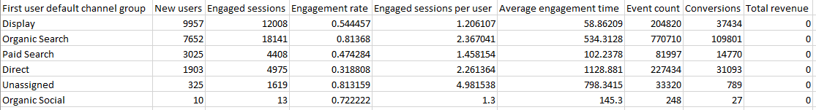
User Acquisition
Here, we have the following columns :-
First user default channel group :- the first column describes about the different channels groups
New users :- as the name describes that they are the new users
Engaged sessions :- total number of engaged sessions
Engagement rate :- it describes the rate of engagement
Engaged sessions per user :- it is calculated by dividing the Engaged sessions by New users
Average engagement time :- its an average time of engagement time
Event count :- it gives us the count of particular event
Conversions :- it displays the conversions

Slide 5
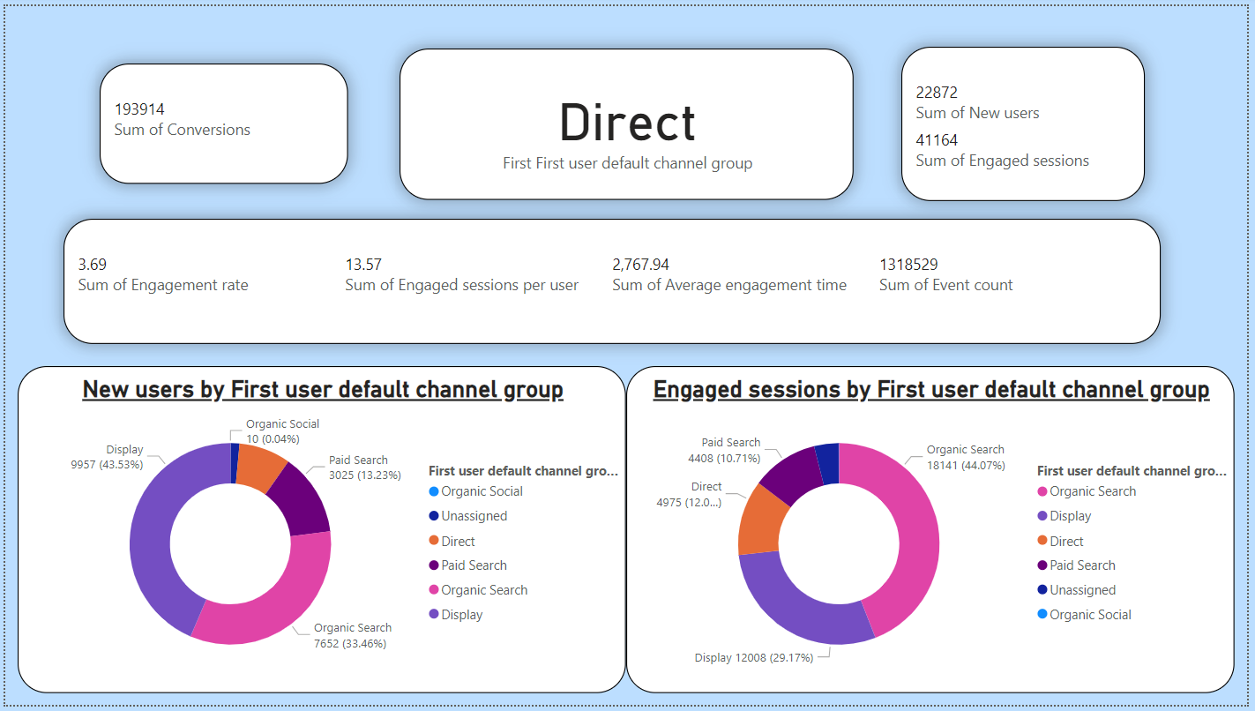

Slide 6
interpretation
Here I have used the cards option from visuals, and arranged it in such a form that is derives some meaning full insights just by looking to it
The 1st card shows the total sum of conversions
Next to that shows the which default channel group is selected there
Next to that it is a multi card which covers the multiple aspects like :-
Sum of Engagement rate
Sum of Engaged sessions per user
Sum of Average engagement time
Sum of Event count
And at the last there are 2 diagrams of donut chart describing the count and percentage of different first user default channel groups for :-
New users
Engaged sessions

Slide 7
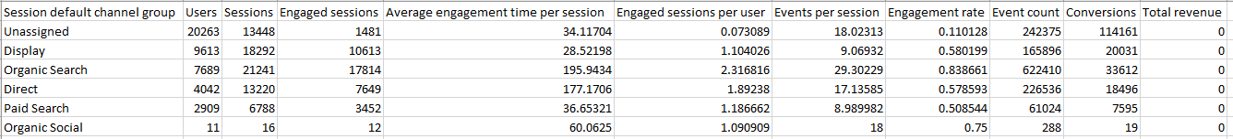

Traffic Acquisition
Session default channel group :- the first column describes about the different session channels groups
Users :- as the name describes that they are the count of users
Sessions :- as the name describes that they are the count of sessions
Engaged sessions :- as the name describes that they are the count of engaged sessions
Average engagement time per session :- it is the average on engagement time for per session. And it Is calculated by taking “Average engagement time” form use acquisition table and dividing it by the session
Engaged sessions per user :- it’s the engages sessions by user
Events per session :- it is showing the count of events per session
Engagement rate :- the percentage of engagement is shown here
Event count :- it’s a count of a particular Event
Conversions :- it is showings the number of conversions

Slide 8
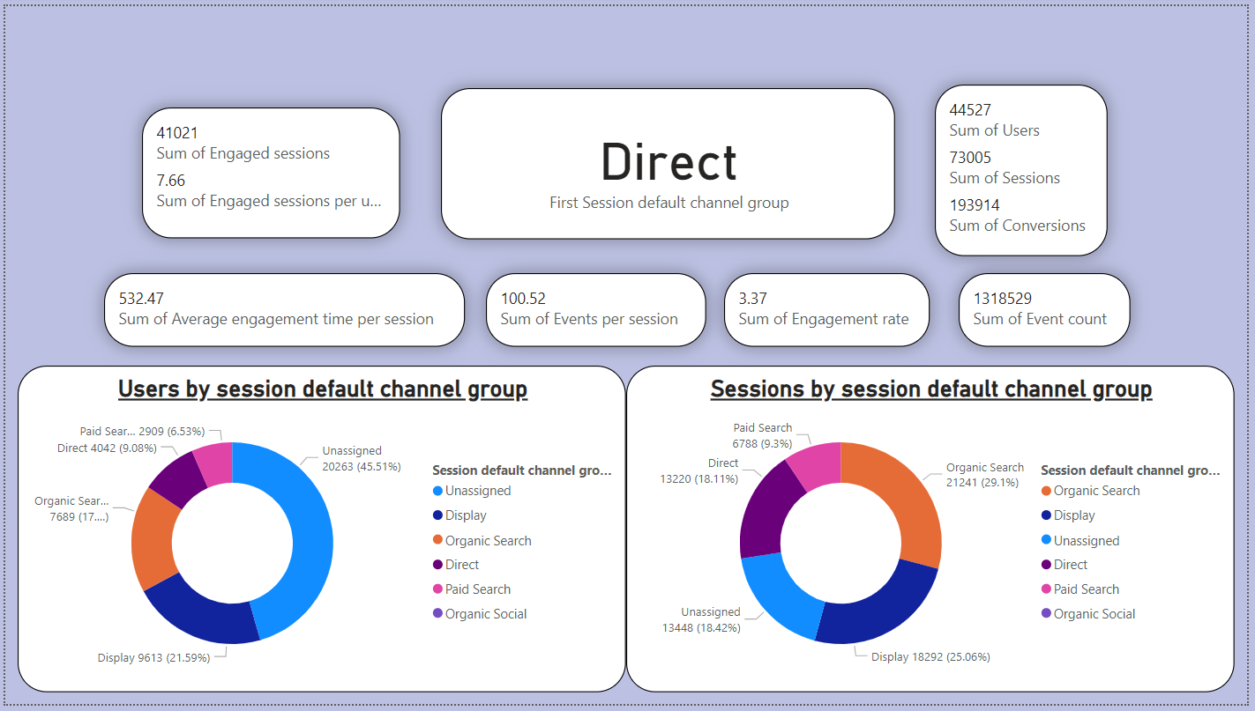

Slide 9
interpretation
Here I have used the cards option from visuals, and arranged it in such a form that is derives some meaning full insights just by looking to it
The 1st multi-card shows the total sum of engaged sessions and total sum of engaged sessions per user
Next to that shows the multi-card describes sum of users, sum of sessions, sum of conversions
Below that Sum of Average engagement time per session, Sum of Events per session, Sum of Engagement rate, Sum of Event count
And at the last there are 2 diagrams of donut charts describing the count and percentage of different session default channel groups for :-
Users
Sessions

Slide 10
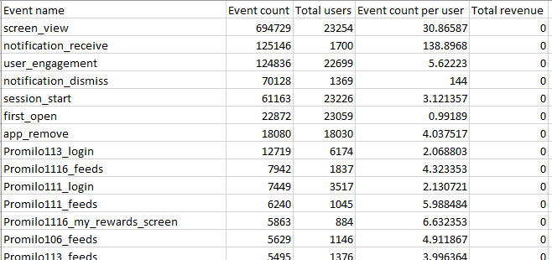
Event Report
There are total 380 rows in this table, out of which some of them are in image
Here I have calculated the correlation between “Event count and Total users” by using the formula as “=CORREL(array1, array2)” and then selecting the columns and I have found that it is 58.983488 %
By 58.98% we can say that the data is having direct relation with the dataset which have been selected for correlation

Slide 11
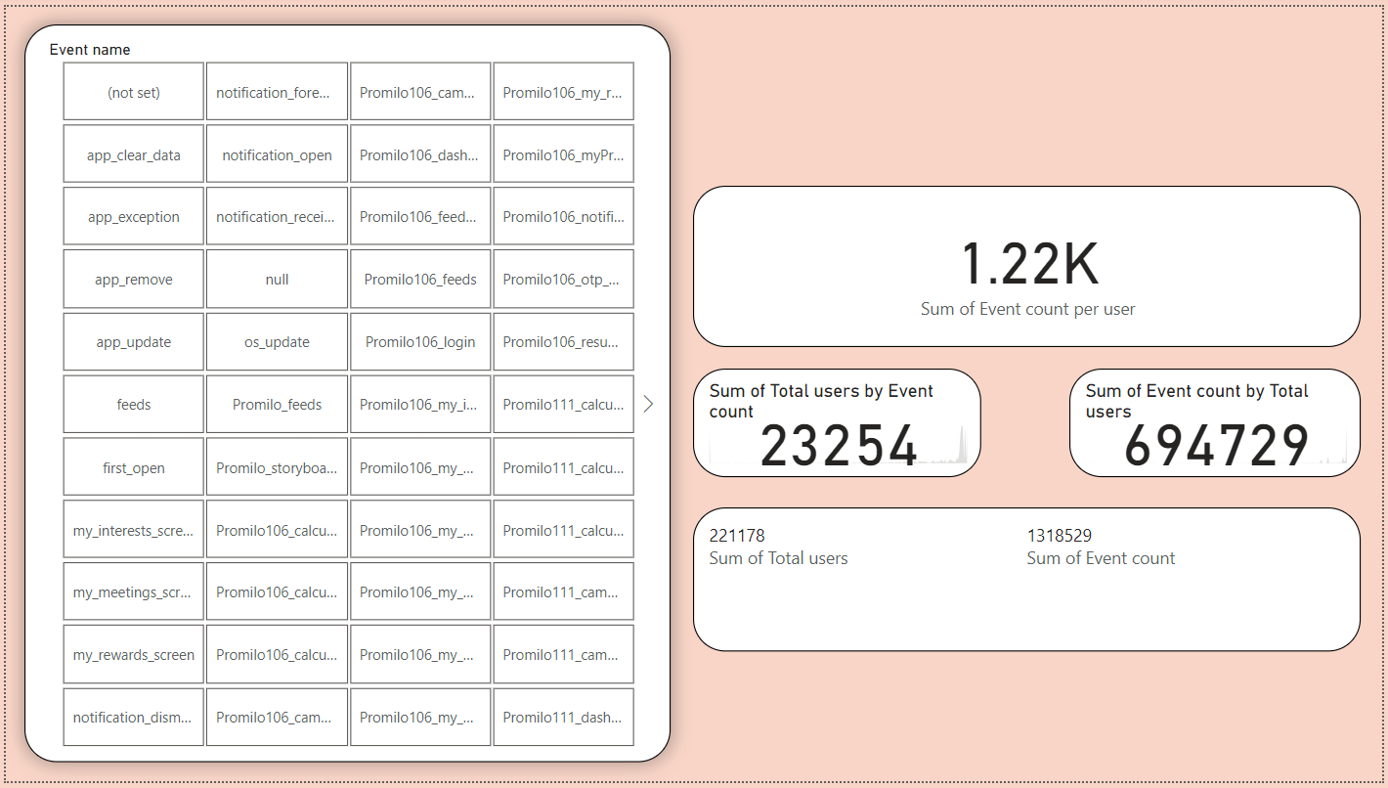

Slide 12
interpretation
Here I have used the slicer option from visuals, and arranged it in such a form that is derives some meaning full insights just by looking to it
The 1st table is slicer table via which you can easily interact with the data. Just by clicking on a tile you will be getting the data respected to that
Next to that shows there is card which shows the sum of event count per user
Below that there are 2 card which respectively display the sum of total users by event count and sum of event count by total users
And at the last it’s a multi-card which shows sum of total users and sum of event count

Slide 13
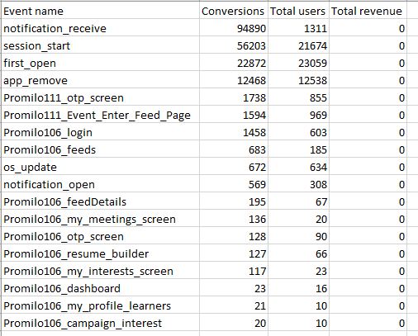
Conversion Report
Event name :- it describes that which particular event it is
Conversions :- count of number of conversions
Total users :- number of total users

Slide 14
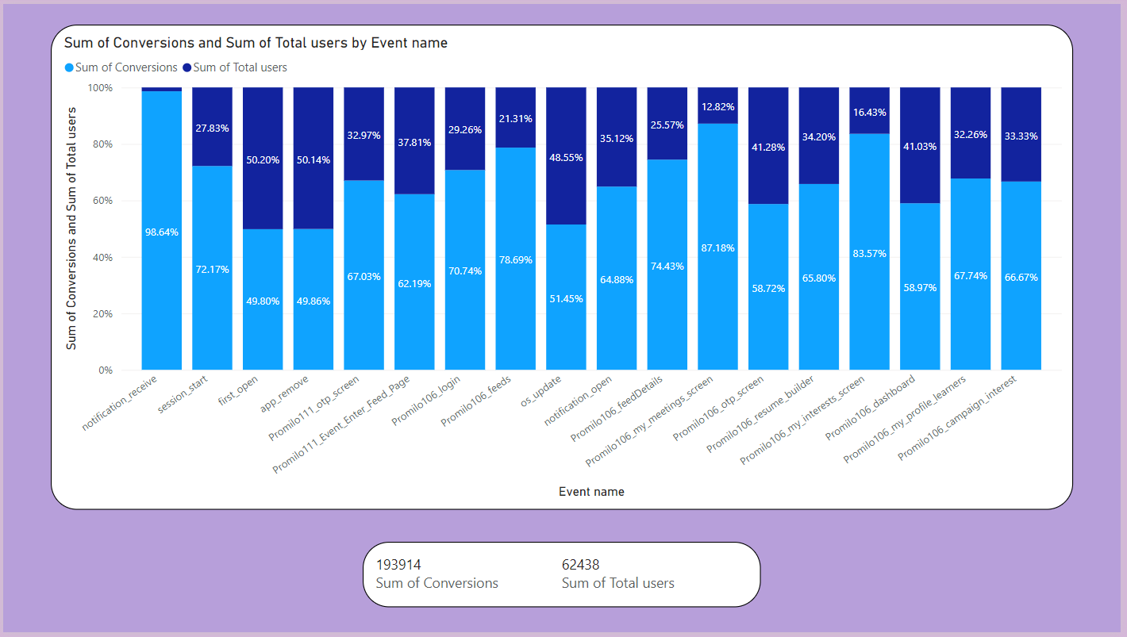

Slide 15
interpretation
Here I have used the 100% stacked column chart option from visuals, and arranged it in such a form that is derives some meaning full insights just by looking to it
Here the visuals is a combination of sum of conversions and sum of total users.
Along with the percentage noted in legends of each bar / column
Then comes the multi-card which tells us about 2 things and they are follows as:-
sum of conversions and
sum of total users

Slide 16
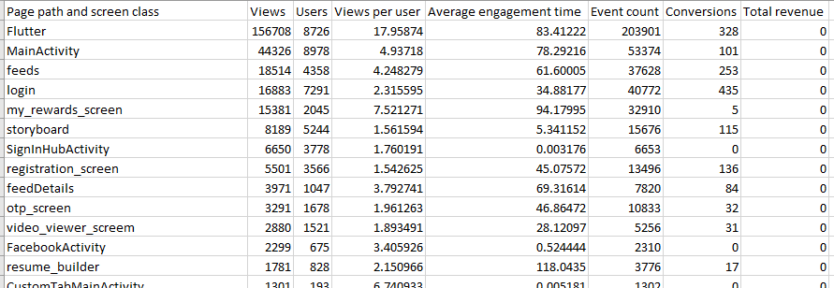
Pages & Screens Report
There are total 43 rows in this table, out of which some of them are in image
Page path and screen class :- it shows the different page paths and the scree classes
Views :- count of the number pf views
Users :- count of users
Views per user :- it shows views per page
Average engagement time :- it describes about the average engagement time
Event count :- it is the count of events
Conversions :- count of conversions

Slide 17
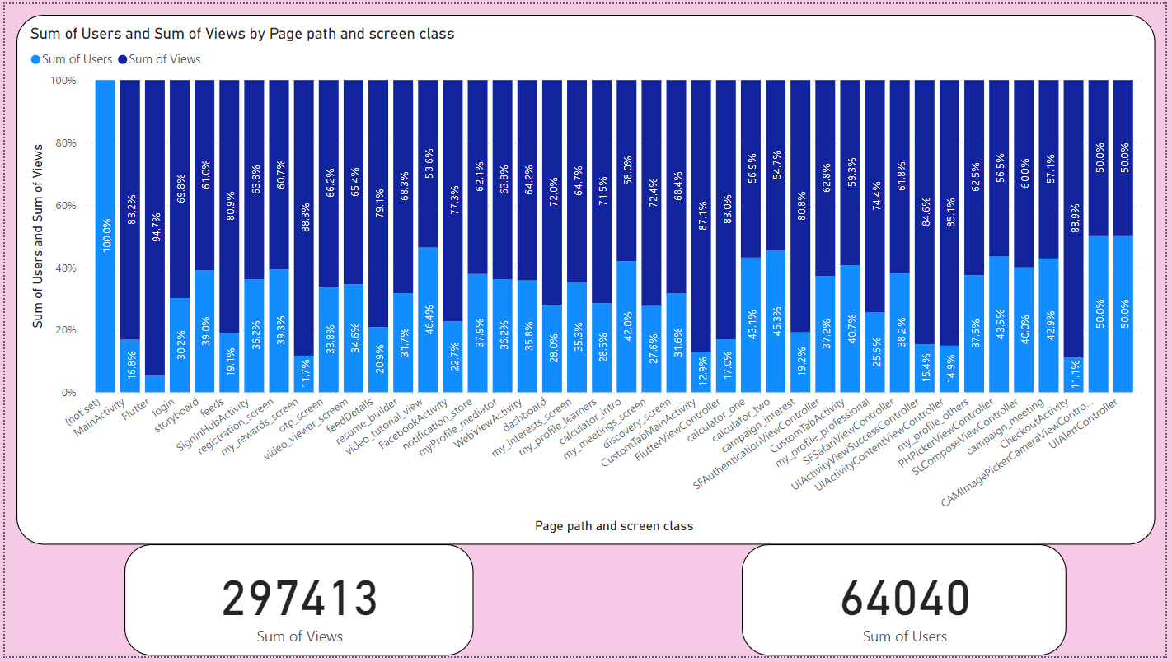

Slide 18
interpretation
Here I have used the 100% stacked column chart option from visuals, and arranged it in such a form that is derives some meaning full insights just by looking to it
Here the visuals is a combination of sum of users and sum of views.
Along with the percentage noted in legends of each bar / column
Then comes the card visual which tells us about 2 things and they are follows as:-
sum of views
sum of total users

Slide 19
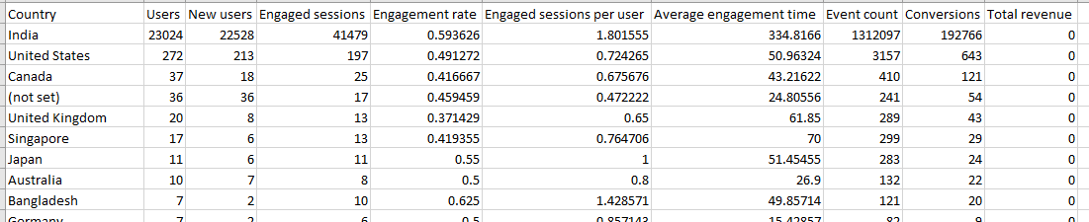

Demographics Report
There are total 48 rows in this table, out of which some of them are in image
Country :- county wise data is distributed for each country
Users :- shows the number of user
New users :- shows the number of new user
Engaged sessions :- it gives the engaged sessions
Engagement rate :- it displays the rate of engagement
Engaged sessions per user :- it shows the count of engaged sessions with respect to user
Average engagement time :- it describes about the average engagement time
Event count :- count of particular events
Conversions :- number of conversions are shown here

Slide 20
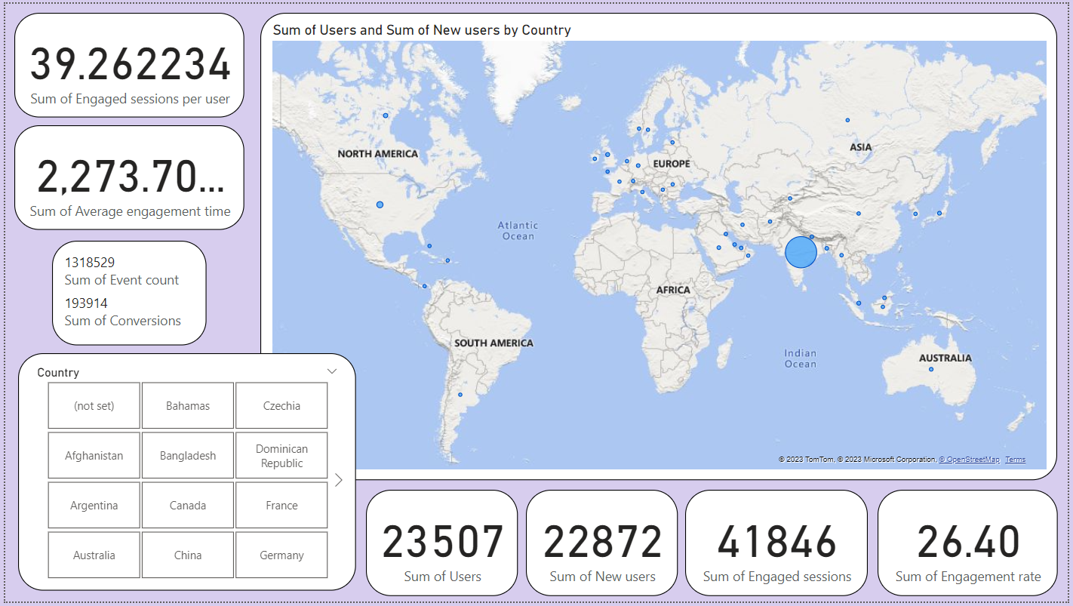

Slide 21
interpretation
Here I have used the map visuals, and arranged it in such a form that is derives some meaning full insights just by looking to it
There is a slicer user to navigate easily from on country data to the other
And there are multiple cards which get changes as per the data is selected by the end user
Some of the cards are :-
Sum of engaged sessions per user
Sum of average engagement time
Multi-card :- sum of event count and sum of conversions
Sum of users
Sum of new users
Sum of engaged sessions
Sum of engagement rate

Slide 22
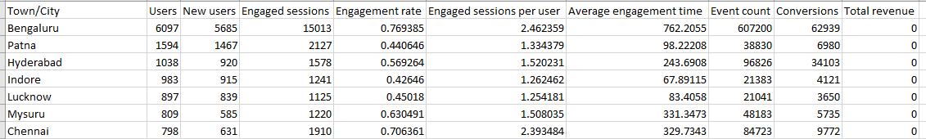

City wise Report
There are total 575 rows in this table, out of which some of them are in image
Town/City :- town/city wise data is distributed for each town/city
Users :- shows the number of user
New users :- shows the number of new user
Engaged sessions :- it gives the engaged sessions
Engagement rate :- it displays the rate of engagement
Engaged sessions per user :- it shows the count of engaged sessions with respect to user
Average engagement time :- it describes about the average engagement time
Event count :- count of particular events
Conversions :- number of conversions are shown here

Slide 23
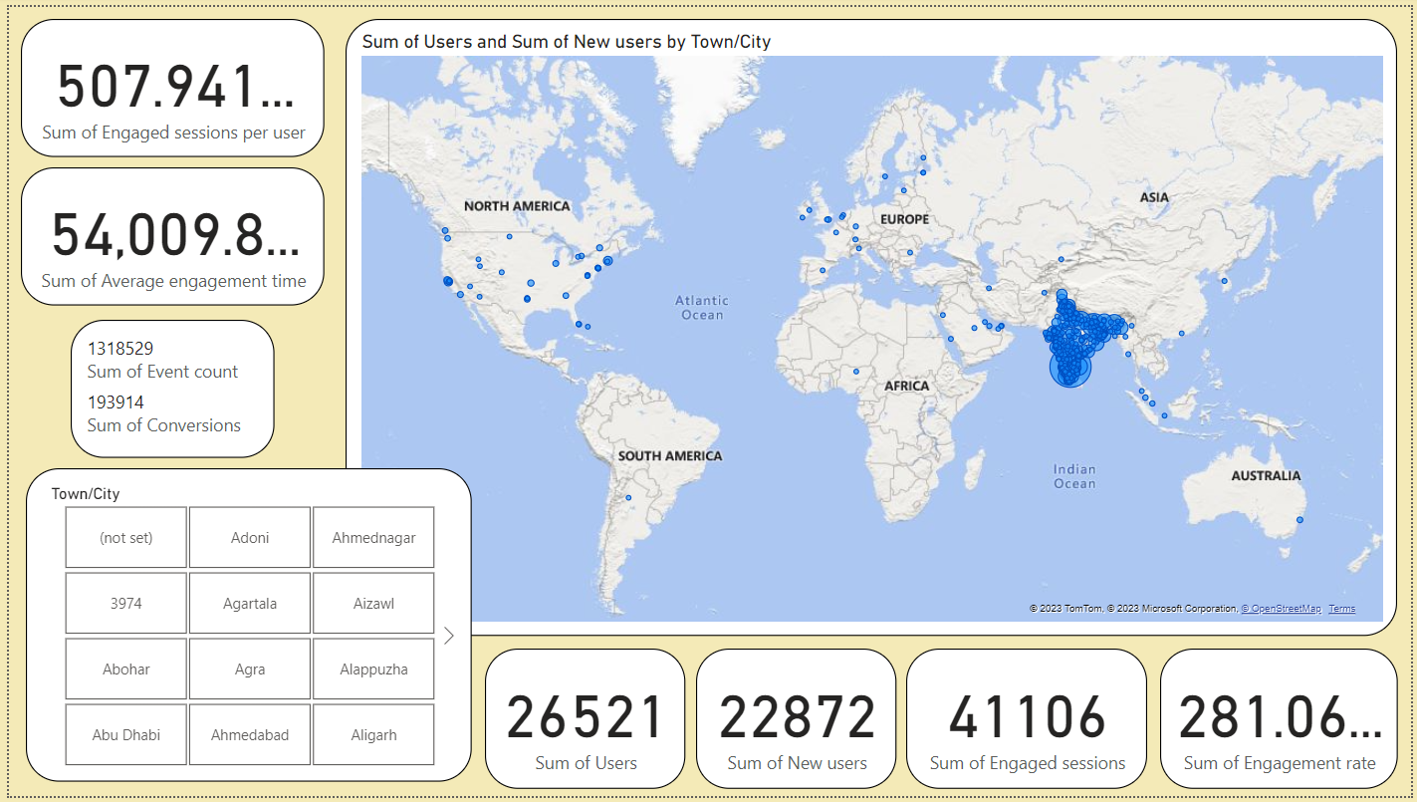

Slide 24
interpretation
Here I have used the map visuals, and arranged it in such a form that is derives some meaning full insights just by looking to it
There is a slicer user to navigate easily from on town / city data to the other
And there are multiple cards which get changes as per the data is selected by the end user
Some of the cards are :-
Sum of engaged sessions per user
Sum of average engagement time
Multi-card :- sum of event count and sum of conversions
Sum of users
Sum of new users
Sum of engaged sessions
Sum of engagement rate

Slide 25
Gender Report
Gender :- it states the what is the gender of audience
Users :- shows the number of user
New users :- shows the number of new user
Engaged sessions :- it gives the engaged sessions
Engagement rate :- it displays the rate of engagement
Engaged sessions per user :- it shows the count of engaged sessions with respect to user
Average engagement time :- it describes about the average engagement time
Event count :- count of particular events
Conversions :- number of conversions are shown here

Slide 26
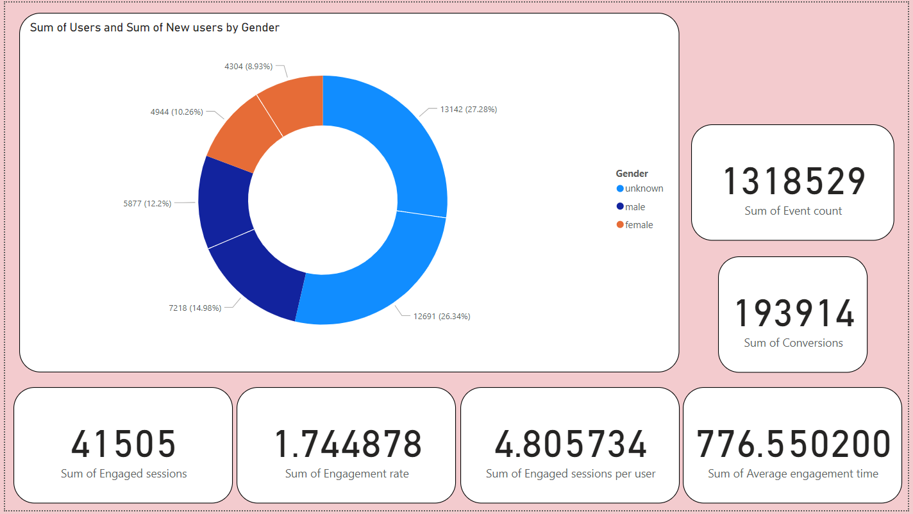

Slide 27
interpretation
Here I have used the donut chart visuals, and arranged it in such a form that is derives some meaning full insights just by looking to it
And there are multiple cards which get changes as per the user selects the data in donut chart
Some of the cards are :-
Sum of event count
Sum of conversions
Sum of average engagement time
Sum of engaged sessions per user
Sum of engagement rate
Sum of engaged sessions

Slide 28
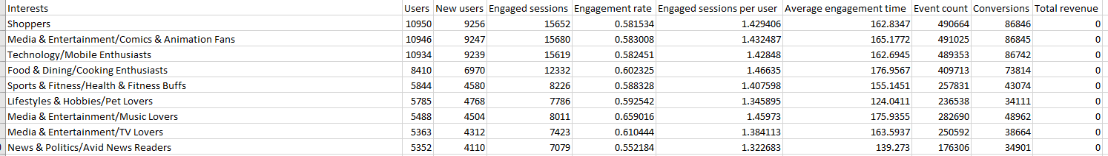

User By Interest
There are total 90 rows in this table, out of which some of them are in image
Interests :- it describes about the
Users :- shows the number of user
New users :- shows the number of new user
Engaged sessions :- it gives the engaged sessions
Engagement rate :- it displays the rate of engagement
Engaged sessions per user :- it shows the count of engaged sessions with respect to user
Average engagement time :- it describes about the average engagement time
Event count :- count of particular events
Conversions :- number of conversions are shown here

Slide 29
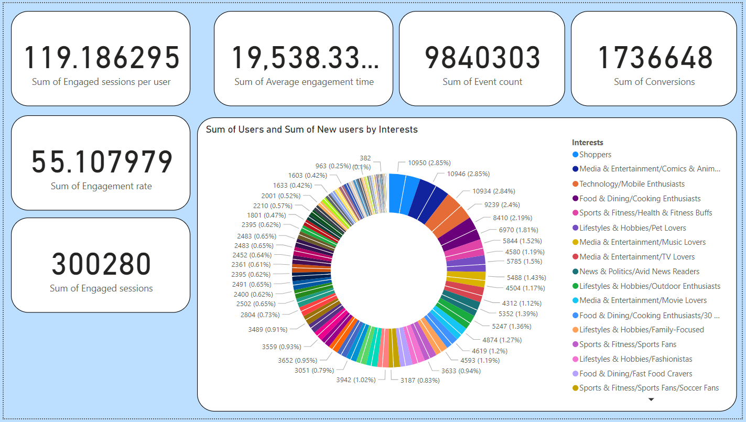

Slide 30
interpretation
Here I have used the donut chart visuals, and arranged it in such a form that is derives some meaning full insights just by looking to it
And there are multiple cards which get changes as per the user selects the data in donut chart
Some of the cards are :-
Sum of conversions
Sum of event count
Sum of average engagement time
Sum of engaged sessions per user
Sum of engagement rate
Sum of engaged sessions

Slide 31
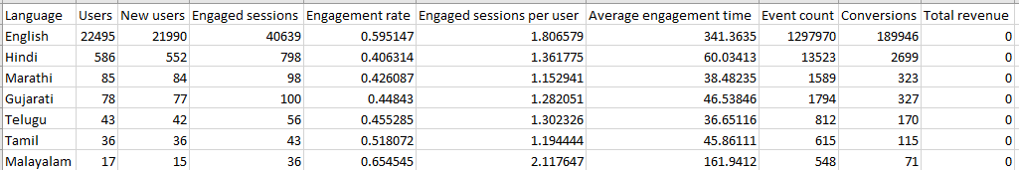
User by Language
There are total 25 rows in this table, out of which some of them are in image
Language :- it displays different languages
Users :- shows the number of user
New users :- shows the number of new user
Engaged sessions :- it gives the engaged sessions
Engagement rate :- it displays the rate of engagement
Engaged sessions per user :- it shows the count of engaged sessions with respect to user
Average engagement time :- it describes about the average engagement time
Event count :- count of particular events
Conversions :- number of conversions are shown here

Slide 32
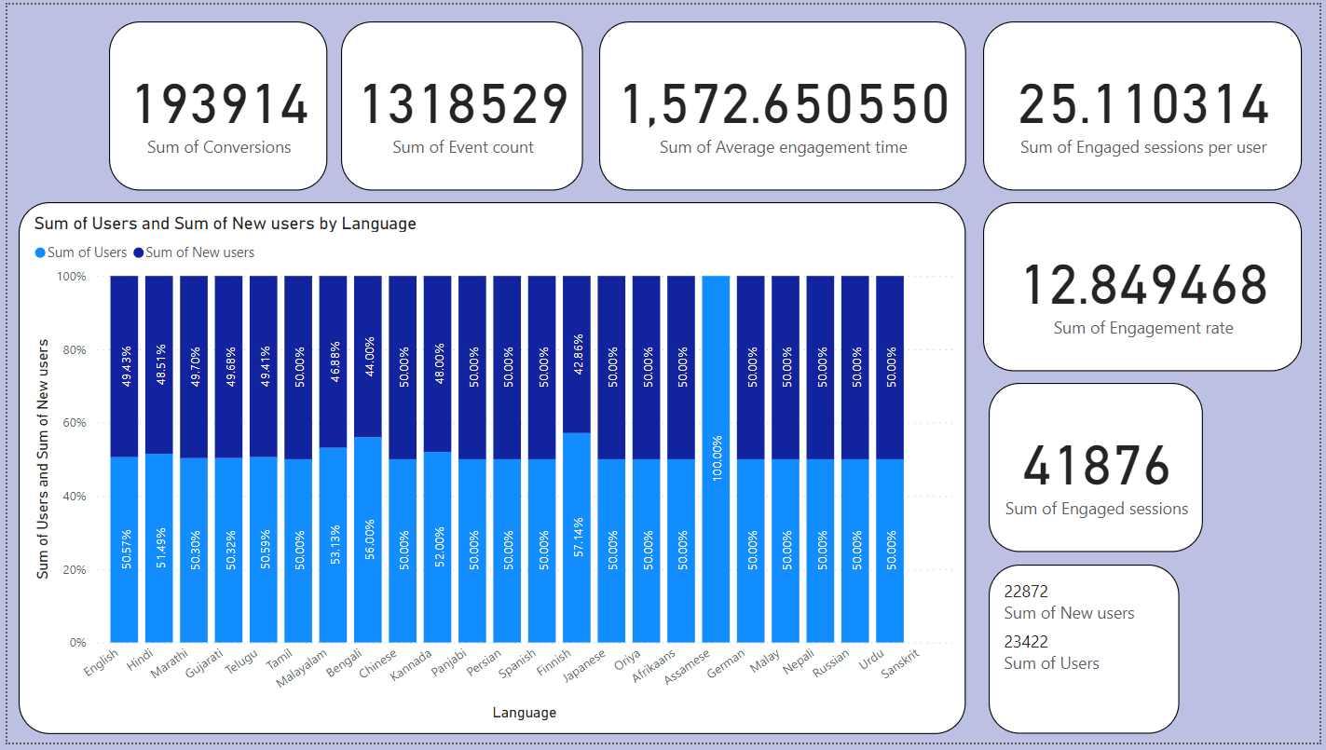

Slide 33
interpretation
Here I have used the 100% stacked column chart option from visuals, and arranged it in such a form that is derives some meaning full insights just by looking to it
Here the visuals is a combination of sum of users and sum of new users.
And there are multiple cards which get changes as per the user selects the data in donut chart
Some of the cards are :-
Sum of conversions
Sum of event count
Sum of average engagement time
Sum of engaged sessions per user
Sum of engagement rate
Sum of engaged sessions
Sum of new users
Sum of users

Slide 34
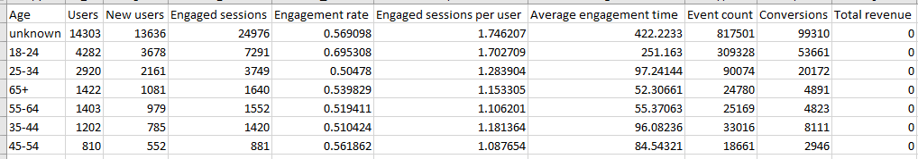
User By Age
Age :- this describes the different age group
Language :- it displays different languages
Users :- shows the number of user
New users :- shows the number of new user
Engaged sessions :- it gives the engaged sessions
Engagement rate :- it displays the rate of engagement
Engaged sessions per user :- it shows the count of engaged sessions with respect to user
Average engagement time :- it describes about the average engagement time
Event count :- count of particular events
Conversions :- number of conversions are shown here

Slide 35
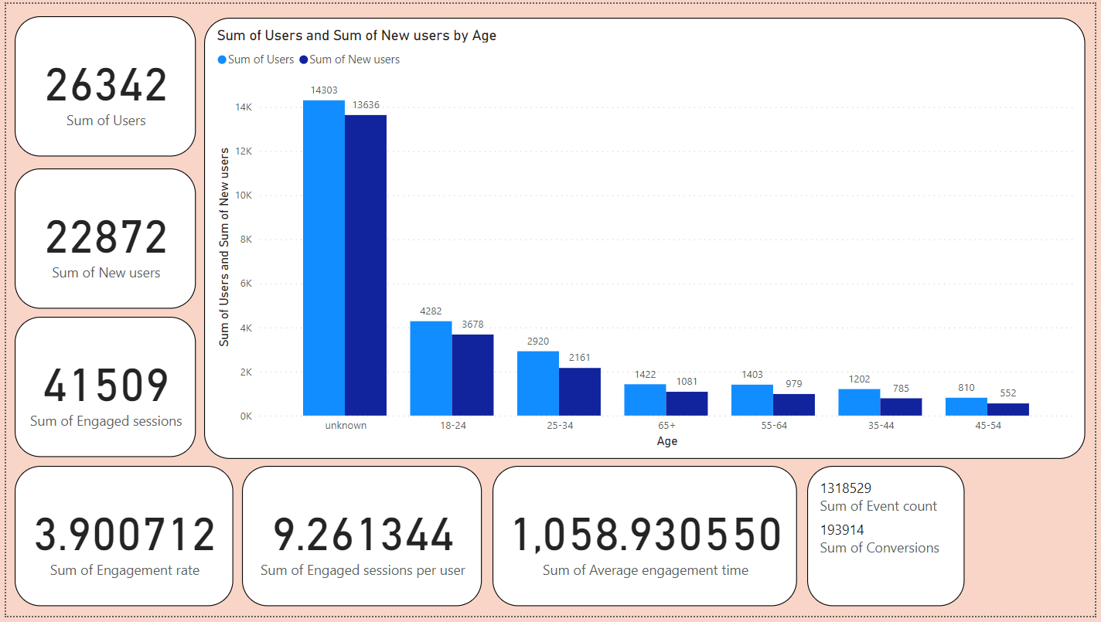

Slide 36
interpretation
Here I have used the clustered column chart option from visuals, and arranged it in such a form that is derives some meaning full insights just by looking to it
Here the visuals is a combination of sum of users and sum of new users.
And there are multiple cards which get changes as per the user selects the data in donut chart
Some of the cards are :-
Sum of conversions
Sum of event count
Sum of average engagement time
Sum of engaged sessions per user
Sum of engagement rate
Sum of engaged sessions
Sum of new users
Sum of users

Slide 37
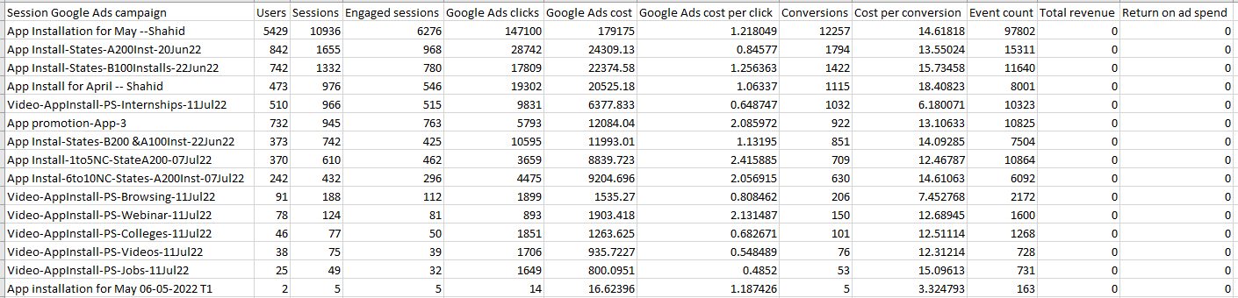
Google Ads Report
Users :- shows the number of user
Sessions :- as the name describes that they are the count of sessions
Engaged sessions :- it gives the engaged sessions
Google Ads clicks :- shows count on number of clicks on google ads
Google Ads cost :- shows cost of google ads
Google Ads cost per click :- shows cost of google ads with respect to clicks
Conversions :- number of conversions are shown here
Cost per conversion :- it shows the cost per conversion
Event count :- count of particular events

Slide 38
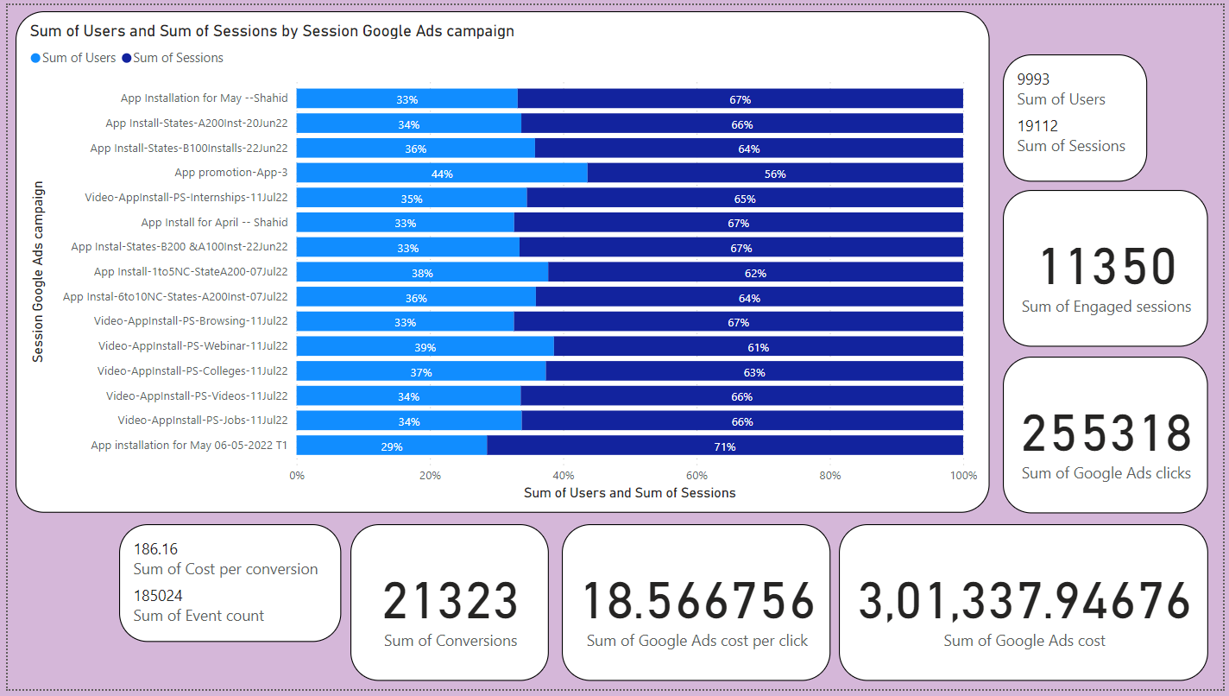

Slide 39
interpretation
Here I have used the 100% stacked bar chart option from visuals, and arranged it in such a form that is derives some meaning full insights just by looking to it
Here the visuals is a combination of sum of users and sum of new sessions.
And there are multiple cards which get changes as per the user selects the data in donut chart
Some of the cards are :-
Sum of cost per conversion
Sum of event count
Sum of conversions
Sum of google ads cost per click
Sum of google ads cost
Sum of google ads clicks
Sum of engaged sessions
Sum of sessions
Sum of users

Slide 40
Thank you

Slide 41
You can find the Dataset file and Power BI file through following links shared below :-
Dataset file (excel file) :- | https://docs.google.com/spreadsheets/d/1uAqsJIpg4i80LBR-qHIYz5a-O9uEIevQ/edit?usp=drive_link&ouid=103782449792378078336&rtpof=true&sd=true
Power BI file :- | https://drive.google.com/file/d/1_OM-5wEW7wFNElzcpv1cWcWsj6eioI1w/view?usp=sharing

